Slide 1
Price Risk Hedge Strategy

Slide 3
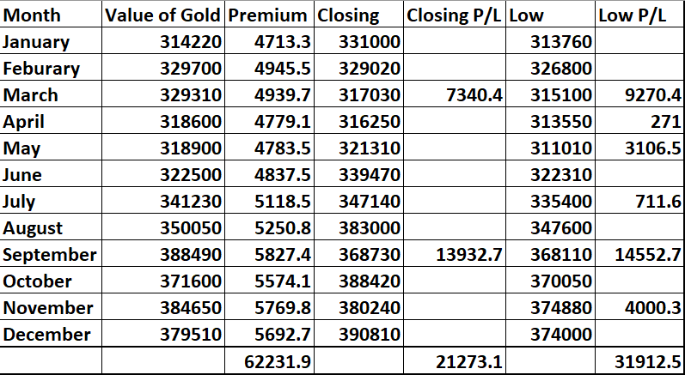
Year 2019
Note:
Premium is the insurance cost that is to be paid monthly.
Net Insurance Cost – 62231.4/380000*100 = 16.38%
Claim Received against Insurance Cost (in case of Closing P/L) – 62231.4-21273.1/38000*100 = 10.78%
Claim Received against Insurance Cost (in case of Low P/L) – 62231.4-31912.3/38000*100 = 7.98%

Slide 4
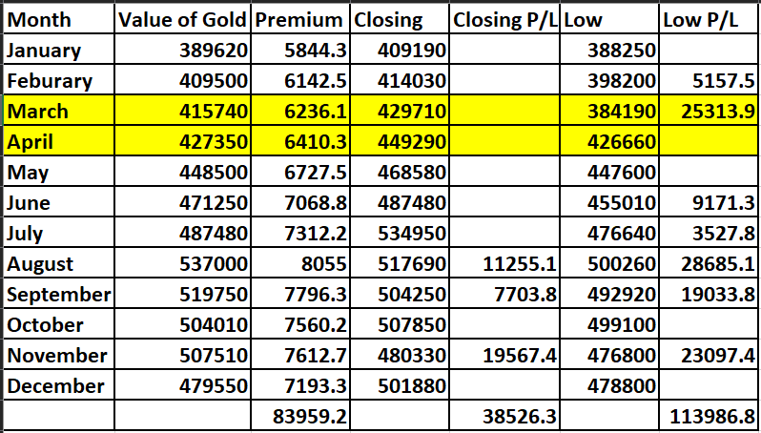
Year 2020
Note:
The highlighted area is the Covid Period.
Premium is the insurance cost that is to be paid monthly.
Net Insurance Cost – 83959.2/480000*100 = 17.49%
Claim Received against Insurance Cost (in case of Closing P/L) – 83959.2-38526.3/480000*100 = 9.47%
Claim Received against Insurance Cost (in case of Low P/L) – 83958.2-113986.6/480000*100 = (6.26%) (Profit)

Slide 5
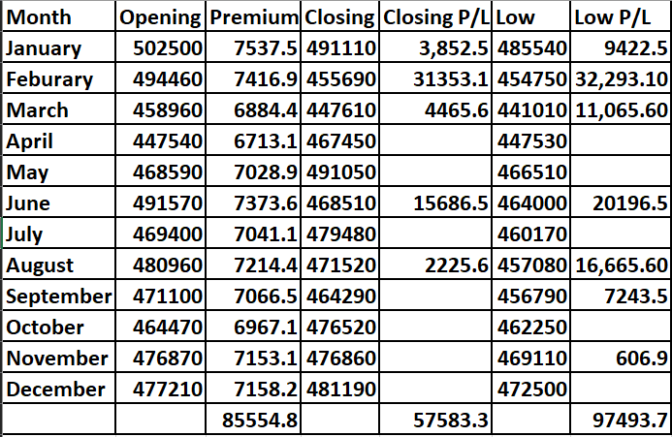
Year 2021
Note:
Premium is the insurance cost that is to be paid monthly.
Net Insurance Cost – 85554.8/477500*100 = 17.92%
Claim Received against Insurance Cost (in case of Closing P/L) – 85554.8-57583.3/477500*100 = 5.86%
Claim Received against Insurance Cost (in case of Low P/L) – 85554.8-97493.7/477500*100 = (2.50%) (Profit)

Slide 6
 | Average Opening | Total Premium Paid | Scenario 1 | Scenario 2
2019 | 345730 | 62231.9 | 40958.8 | 30319.4
2020 | 466438 | 83959.2 | 45432.9 | (30027.6)
2021 | 475302 | 85554.8 | 27971.5 | (11938.9)
Average Total | 429157 | 77248.6 | 38121.1 | (3882.4)
Percentage |  | 18.00% | 8.88% | (0.90)%

Slide 7
Year | Insurance with Claim | Insurance with Advisory
2019 | 10.78% | 7.98%
2020 | 9.47% | -6.26%
2021 | 4.38% | -3.98%
Average | 8.21% | -0.75%

Slide 8
Insurance will always cost you.
Don’t think to make profit out of it.

